Slide 1




NEXT GEN EMPLOYABILITY PROGRAM
Creating a future-ready workforce
Team Members
College Name
Student Name : Dhanush Verthanan S
Student ID : 622021104022
Paavai College of Engineering

Slide 2

CAPSTONE PROJECT SHOWCASE
Project Title
Building Bus Reservation System using Python and Django
Abstract | Problem Statement | Project Overview | Proposed Solution | Technology Used | Modelling & Results | Conclusion

Slide 3
Abstract : Online Bus Ticket Reservation System
Welcome to BusTicketReserve.com, your one-stop solution for hassle-free bus ticket reservations. Whether you're planning a short trip or a long journey, our user-friendly online platform makes booking bus tickets a breeze. Say goodbye to long queues and last-minute rushes – with BusTicketReserve.com, your travel experience begins with ease.
Key Features: Intuitive Booking Interface: Our website boasts an intuitive booking interface designed to simplify the reservation process. With just a few clicks, you can search for available buses, select your preferred seats, and confirm your booking – all from the comfort of your home or office.
Extensive Route Network: BusTicketReserve.com offers an extensive network of routes, covering major cities and towns across the country. Whether you're traveling for business or leisure, you'll find a wide range of destinations to choose from, ensuring convenient connectivity wherever you go.
Flexible Payment Options: We understand the importance of flexibility when it comes to payment. That's why we offer a variety of payment options, including credit/debit cards, net banking, and mobile wallets, making it easy for you to complete your booking securely and conveniently.
Real-Time Seat Availability: Never worry about seat availability again. Our website provides real-time updates on seat availability, allowing you to choose the perfect seat for your journey without any last-minute surprises.

Slide 4
Problem Statement
Problem Statement:
In today's fast-paced world, the process of booking bus tickets often poses various challenges for travelers. Long queues at ticket counters, limited seat availability, and the lack of convenient payment options are just a few of the issues faced by individuals seeking to reserve bus tickets for their journeys. Additionally, the absence of real-time updates on seat availability and the potential risks associated with online transactions further compound the difficulties encountered during the booking process.
Inconvenient Booking Process: Traditional methods of booking bus tickets involve long queues at ticket counters, leading to time-consuming and frustrating experiences for travelers.
Limited Seat Availability: Without access to real-time updates on seat availability, travelers often face uncertainty and frustration when attempting to secure tickets for their preferred travel dates and routes.
Lack of Convenient Payment Options: Many existing platforms offer limited payment options, restricting travelers to a narrow range of payment methods that may not be suitable for everyone.

Slide 5
Project Overview
BusTicketReserve.com is an online bus ticket reservation system designed to streamline the process of booking bus tickets for travelers. The platform offers a user-friendly interface, extensive route coverage, flexible payment options, real-time seat availability updates, robust security measures, and round-the-clock customer support to ensure a seamless booking experience.
Key Features:
Intuitive Booking Interface: The website features an easy-to-use interface that allows users to search for available buses, select preferred seats, and complete bookings effortlessly.
Extensive Route Coverage: BusTicketReserve.com offers a comprehensive network of routes, connecting major cities and towns across the country to provide travelers with convenient connectivity options.
Flexible Payment Options: Users can choose from a variety of payment methods, including credit/debit cards, net banking, and mobile wallets, to complete their bookings securely and conveniently.

Slide 6
Proposed Solution
.
BusTicketReserve.com aims to address the challenges faced by travelers when booking bus tickets by providing a comprehensive and user-friendly online platform. The proposed solution includes the following key elements:
Intuitive User Interface:
Develop an intuitive and user-friendly website interface that simplifies the booking process for users of all levels of technological proficiency.
Implement a clean and responsive design that is optimized for both desktop and mobile devices, ensuring a seamless experience across all platforms.
Extensive Route Coverage:
Partner with a wide network of bus operators to offer an extensive range of routes, covering major cities, towns, and popular tourist destinations.
Provide detailed information about each route, including departure and arrival times, duration, and stops along the way, to help users make informed decisions.
Flexible Payment Options:
Integrate multiple payment gateways to offer users a variety of payment options, including credit/debit cards, net banking, and popular mobile wallets.
Ensure that all payment transactions are processed securely using industry-standard encryption protocols to protect users' sensitive information.

Slide 7
Implementation Approach:
Requirements Gathering:
Conduct thorough research to understand the needs and preferences of target users.
Gather requirements regarding features, functionality, and design elements for the BusTicketReserve.com platform.
Technology Stack Selection:
Choose appropriate technologies and frameworks for frontend development (e.g., HTML5, CSS3, JavaScript) and backend development (e.g., Node.js, Python Django, Ruby on Rails).
Select suitable database technologies (e.g., MySQL, PostgreSQL, MongoDB) for storing user data, booking information, and route details.
Frontend Development:
Develop the user interface of the BusTicketReserve.com website using HTML, CSS, and JavaScript.
Implement responsive design principles to ensure compatibility with a wide range of devices and screen sizes.
Backend Development:
Build the backend infrastructure using the selected programming language and framework.
Implement the necessary APIs and services for handling user authentication, booking requests, seat availability updates, and payment processing.

Slide 8


Technology Used
Front-end
Back-end

Slide 9
Modelling & Results
User Model:
Define user profiles based on demographics, preferences, and past booking history.
Capture user information such as name, contact details, and payment preferences.
Bus Route Model:
Create a database of bus routes, including origin, destination, departure times, and stops along the route.
Assign unique identifiers to each route for easy reference and retrieval.
Bus Model:
Model buses with attributes such as seating capacity, amenities, and operator details.
Maintain a record of available buses for each route and schedule.
Booking Model:
Implement a booking model to track reservations made by users.
Include information such as booking ID, user ID, bus ID, seat numbers, and payment status.
Payment Model:
Model payment transactions to record successful payments and pending transactions.
Store details such as transaction ID, amount, payment method, and timestamp.

Slide 10
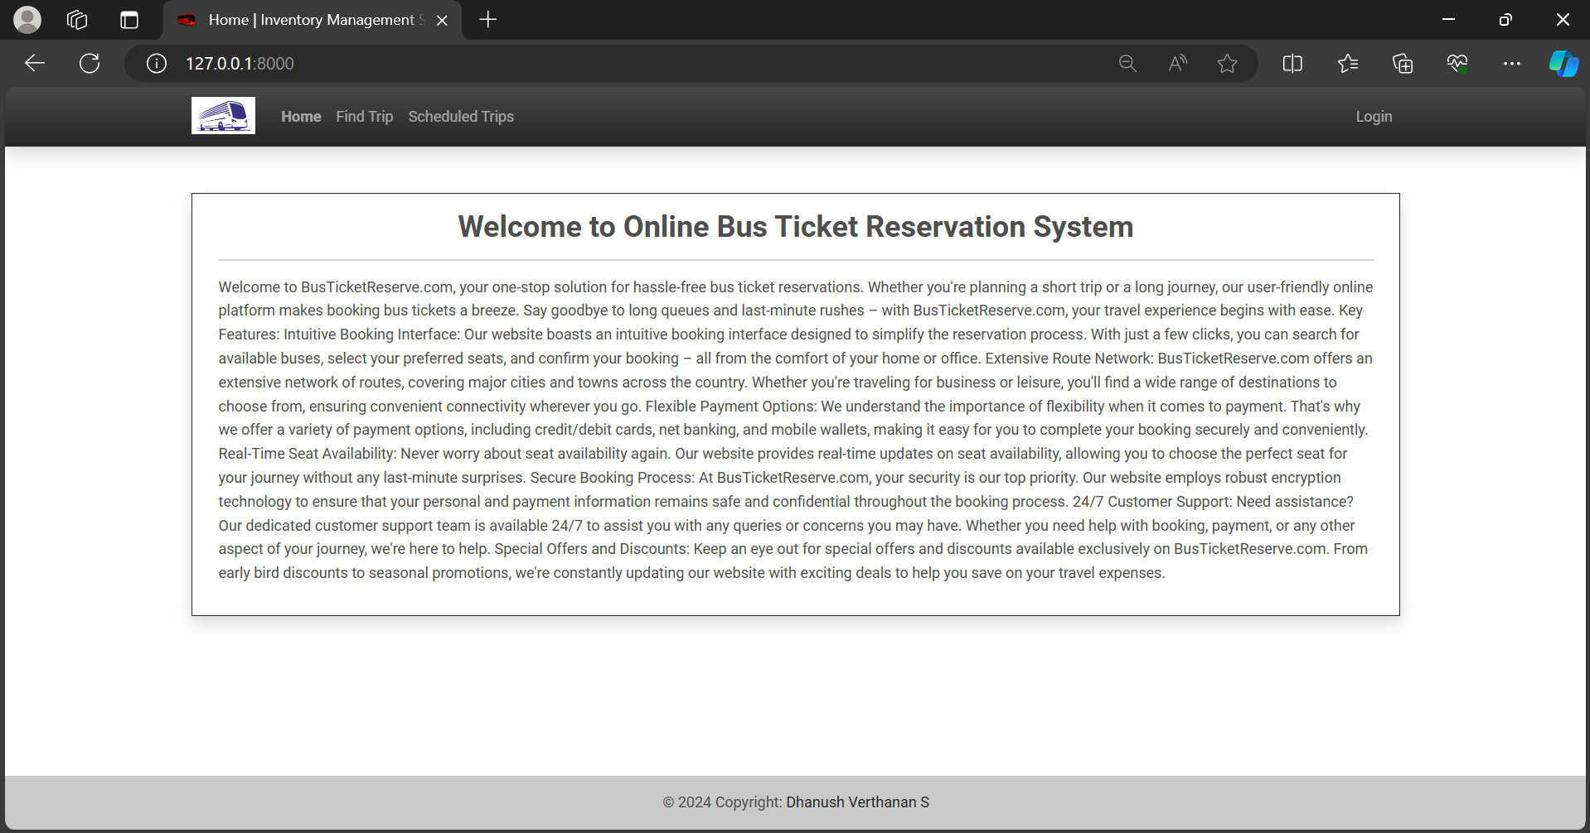
Homepage

Slide 11
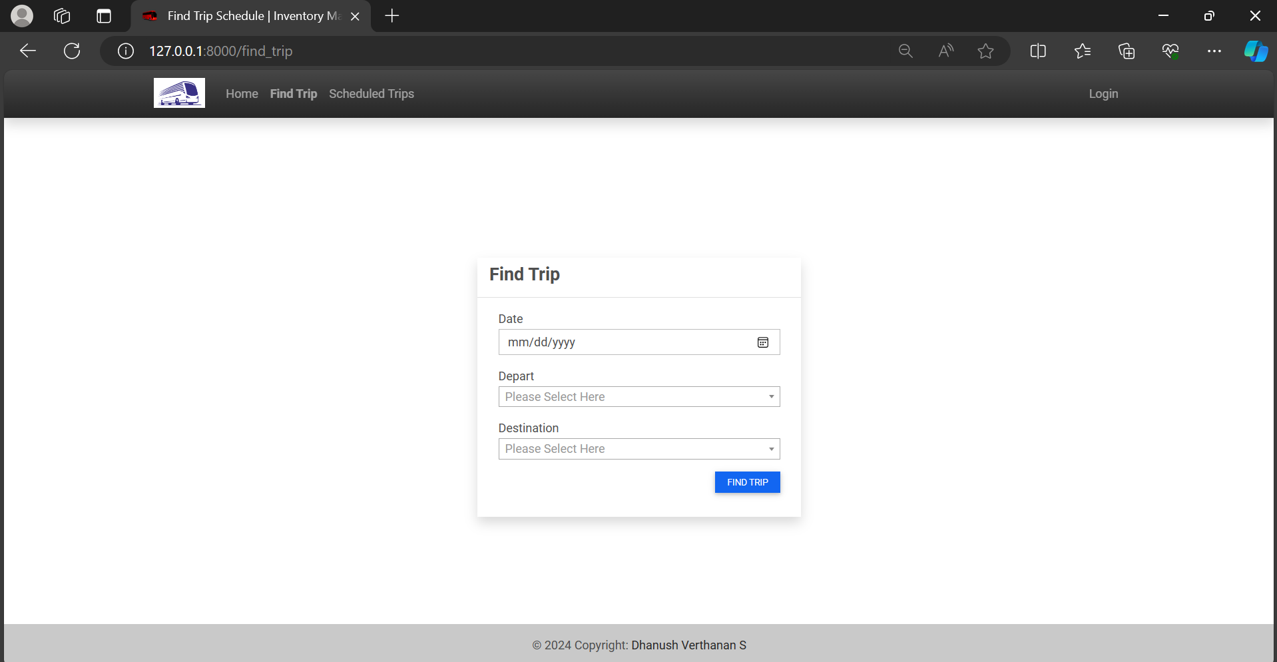
Service-Page

Slide 12
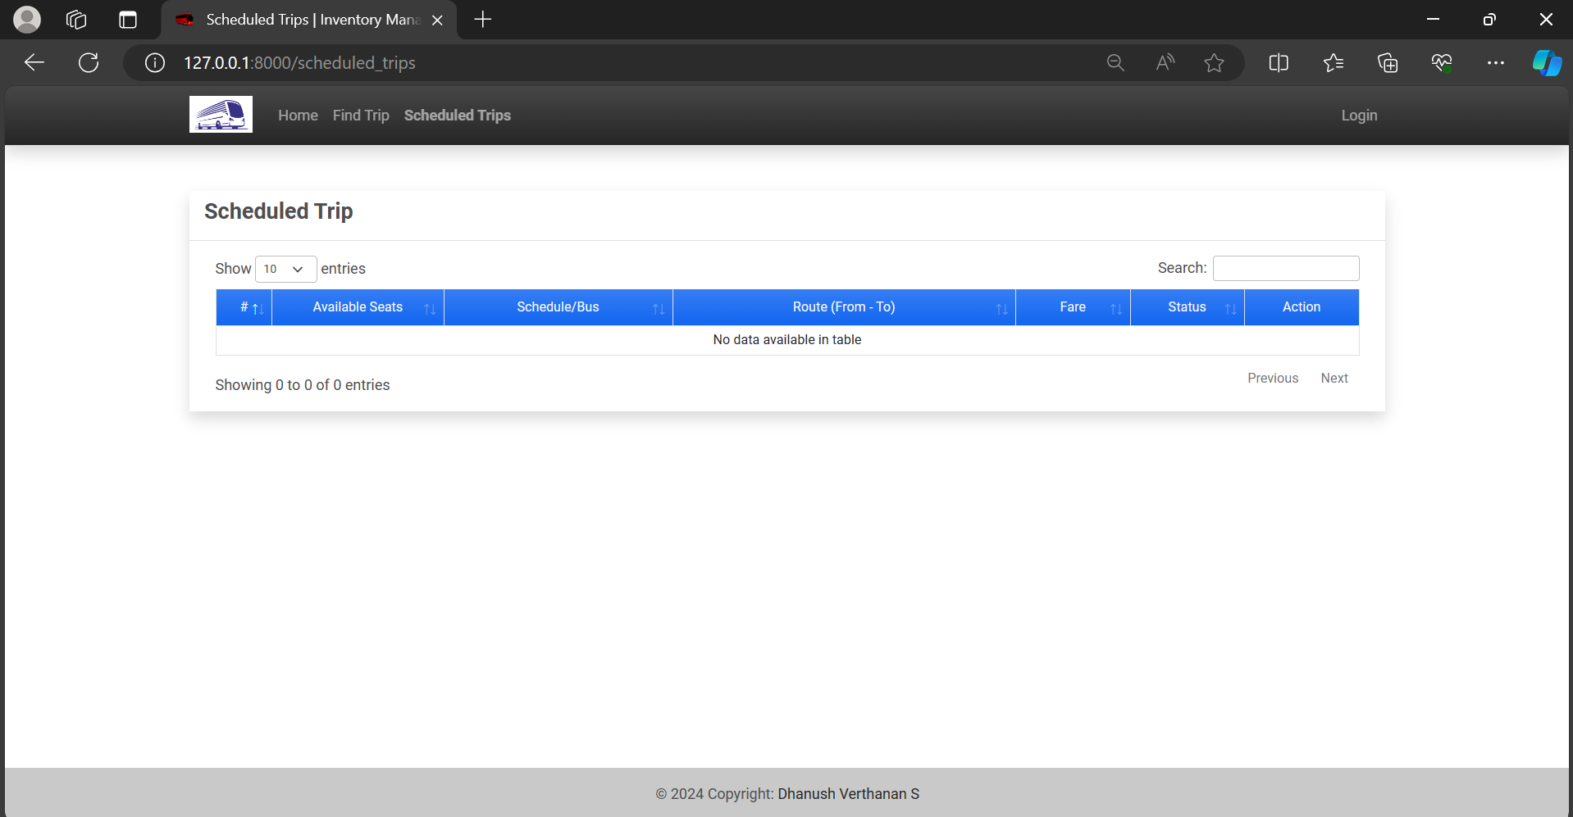
Departments-Page

Slide 13
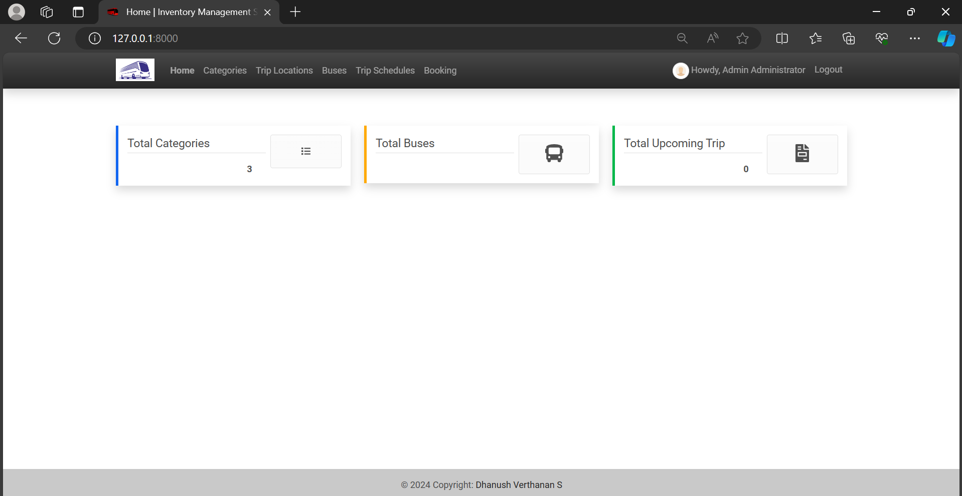
Blog-Page

Slide 14
About-Us-Page

Slide 15
Future Enhancements:
Personalized Recommendations:
Implement algorithms to analyze users' past booking history and preferences, allowing for personalized recommendations for routes, schedules, and promotions tailored to each user's interests.
Multi-Language Support:
Introduce support for multiple languages to cater to a diverse user base, enhancing accessibility for travelers from different regions and linguistic backgrounds.
Integration with Travel Partners:
Partner with airlines, hotels, and other travel service providers to offer integrated booking options, allowing users to plan and book their entire journey seamlessly from a single platform.
Dynamic Pricing:
Develop dynamic pricing algorithms to adjust ticket prices based on factors such as demand, seasonality, and availability, optimizing revenue and offering competitive pricing for users.
Mobile App Development:
Create dedicated mobile applications for iOS and Android devices, providing users with a convenient way to book tickets and manage their travel plans on the go.

Slide 16
Conclusion
BusTicketReserve.com stands as a testament to the transformational power of technology in revolutionizing the travel industry. Through its intuitive interface, extensive route network, flexible payment options, and commitment to security and customer satisfaction, BusTicketReserve.com has redefined the bus ticket booking experience for travelers worldwide.
By providing a seamless and user-friendly platform, BusTicketReserve.com has not only simplified the process of booking bus tickets but has also enhanced accessibility and convenience for travelers of all backgrounds. The platform's real-time updates on seat availability, secure payment processing, and round-the-clock customer support have instilled confidence and trust among users, leading to high levels of satisfaction and loyalty.
Looking ahead, BusTicketReserve.com remains committed to innovation and continuous improvement. Future enhancements such as personalized recommendations, multi-language support, and dynamic pricing will further elevate the user experience and solidify BusTicketReserve.com's position as a leader in the online travel industry.
As travelers increasingly turn to digital platforms to plan and book their journeys, BusTicketReserve.com stands ready to meet their evolving needs and preferences, ensuring that every journey begins with ease, convenience, and peace of mind. With its unwavering dedication to excellence and customer-centric approach, BusTicketReserve.com is poised to shape the future of bus travel, one reservation at a time.

Slide 17
Thank You!
Notes:
Thank You !!

